Slide 1
EDI Test Data Library
Generate a large volume of various EDI files to test the VA processing program written in Python using an abstract database. This helps ensure the system can reliably handle production-level traffic and safeguards uninterrupted access to the healthcare access that the millions of veterans rely on.

Slide 2
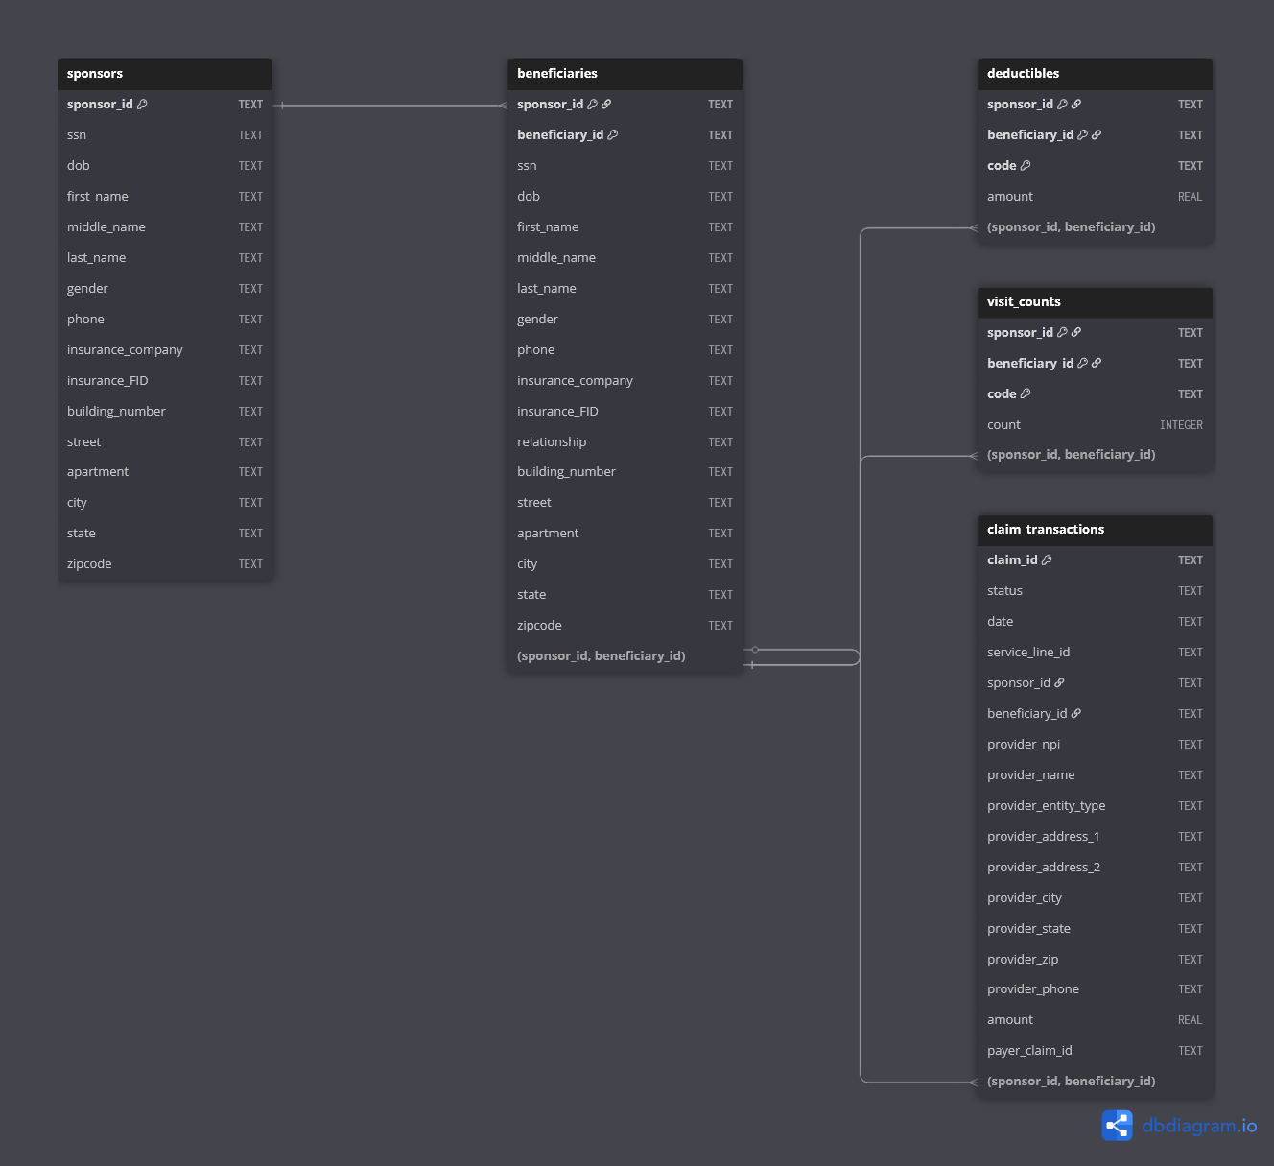
Key Features/
Achievements
Entity Relationship Diagram
Data generation
Generates realistic fake sponsors and beneficiaries for use in EDI files.
Also supports the ability to insert custom values via CSV
Speed
Generates 100,000 beneficiaries, 120,000 claim transactions, and 5,000 EDI files of each kind within 2 minutes (depends on hardware)
Dataflow
Maintains consistent data state across files. A beneficiary used in a 270 will be reused in related files such as the 837 or 277 to ensure continuity

Slide 3
EDI Workflow
Eligibility Inquiry (270)
Healthcare Claim (837)
Claim Acknowledgement (277CA)
Healthcare Payment (835)
Enrollment Update (834)
Checks beneficiary’s eligibility for healthcare services with a payer
Submits healthcare claims for services performed
Acknowledges receipt and processing of 837
Communicates payment details and adjustments
Updates beneficiary enrollment data
- Sponsor and beneficiary information generated
- Claim transaction information generated
- Uses sponsor and beneficiary information
- Uses claim control numbers
- Uses claim control numbers
- Uses claim payment amount
- Uses claim control numbers
- Uses claim payment amount
- Uses sponsor and beneficiary to update the values (deductibles/visits used)

Slide 4
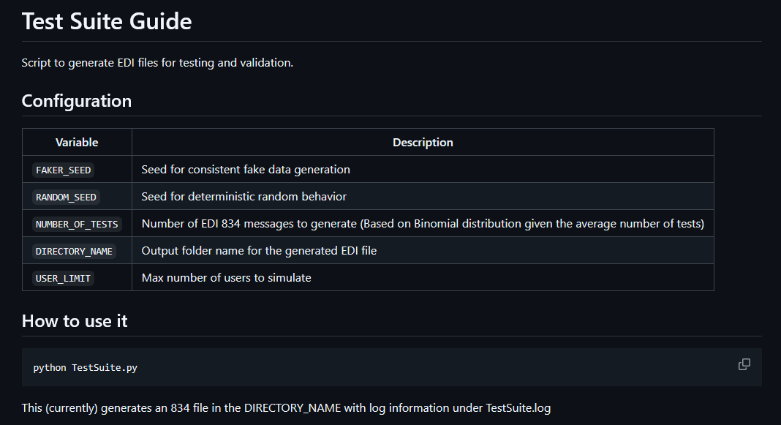
Challenges/Learnings
EDI File Format
Meeting Charter Requirements
Documentation
Learning the EDI file format was initially tough, but once I started working with it more, it made more and more sense.
Each file consists of an envelope and within the envelopes there are transactions that consist of loops which has information within them
Requirements for the project can change abruptly and the ability to adapt is really important. A big change was maintaining state between files. Originally created just 834 and didn’t store information
My initial documentation was really minimal so I had to take a step back and reconsider how someone with no knowledge of my program would begin to use it

Slide 5
Resources
Stedi – HIPAA X12 requirements
EDINation -- EDI file validator

